Slide 1
Virtual Machines and Runtime
Using Rhino as an example

Slide 2
What is a Virtual Machine?
A virtual machine is a software-defined computer whose purpose is to simulate a physical machine, running on a « host » machine as a « guest ».
Hardware simulated: CPU, memory, hard drive, network interfaces, etc.
Source: https://www.vmware.com/topics/glossary/content/virtual-machine

Slide 3
Types of Virtual Machines
System virtual machine
Process virtual machine
Used to substitute a physical machine
Using an hypervisor that can run directly on hardware (VMware ESXI) or on top of an OS (VirtualBox).
Used for executing a single process
Masks the information of the underlying hardware/OS
Java Virtual Machine

Slide 4
Java Virtual Machine (JVM)
Virtual Machine that allows the execution of programs compiled to Java bytecode.
Follows a standard required in a JVM implementation.
The JVM simulates a 32-bit machine.
Offers a garbage collector for removing dereferenced objects.

Slide 5
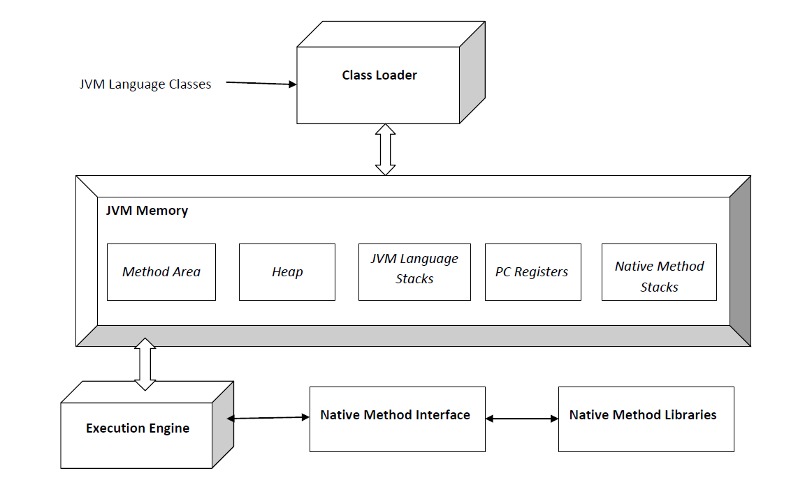
Java Virtual Machine (JVM)

Slide 6
Runtime Environment (RTE)
The runtime of a program is the execution and running phase.
A Runtime Environment provides all the functionalities and dependencies necessary to run a program independently of the underlying operating system, which allows the program to have the same user interfaces regardless of the OS.
Provides basic functions for memory, network and hardware.
Source: https://www.ionos.com/digitalguide/websites/web-development/what-is-a-runtime-environment

Slide 7
Java Runtime Environment (JRE)
Combines the Java code created with the JDK with the dependencies required (libraries) and creates an instance of the JVM to run the resulting program.
Enables a Java program to run in any OS without modification.
Source:
https://www.ibm.com/cloud/learn/jre
Architecture:
ClassLoader: loads all the classes of the Java program.
Bytecode verifier: Checks the format and accuracy of the Java code.
Interpreter

Slide 8
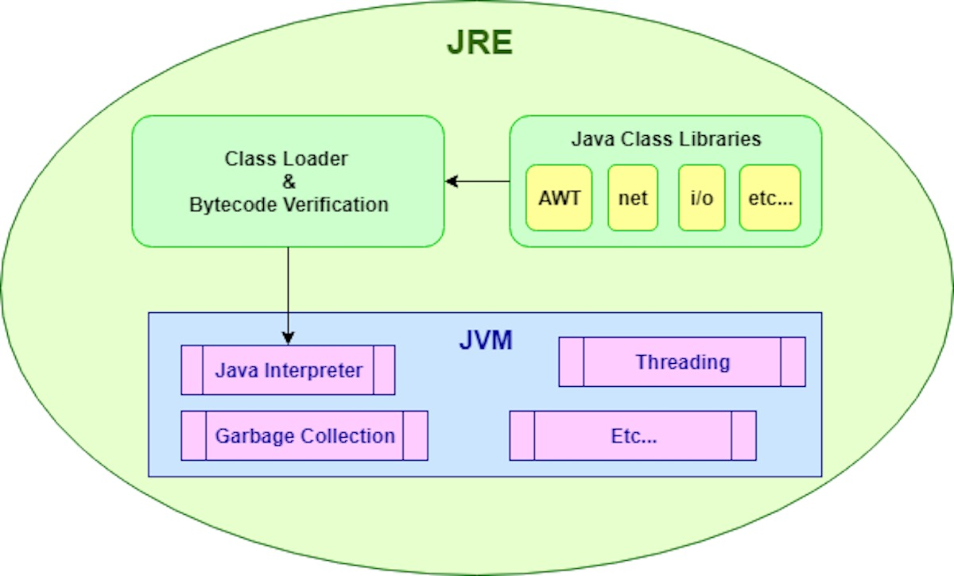
Java Runtime Environment (JRE)

Slide 9
Interpreter vs Compiler
Interpreter
Compiler
Translates program at runtime, one statement at a time.
Source: https://www.programiz.com/article/difference-compiler-interpreter
Scans the program and translates it into machine code.

Slide 10
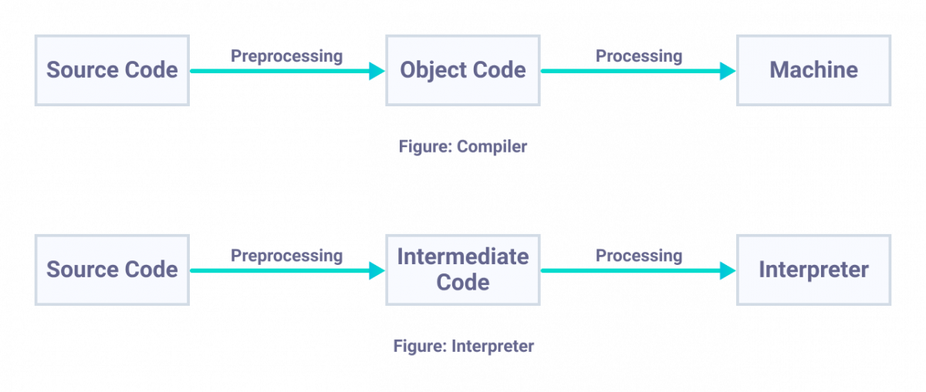
Interpreter vs Compiler

Slide 11
Compiler
A compiler is a program that translates source code into another lower-level language.
Different types of compilers: TODO

Slide 12
Phases of a Compiler
Front end
Back end
Lexical Analysis
Syntax Analysis
Semantic Analysis
Intermediate Code Generation
Optimization
Code Generation

Slide 13
Just-In-Time (JIT) Compiler
Used to improve the performance of Java applications.
Compiles « just in time » bytecodes into native machine code at runtime.
The JVM calls the compiled code instead of interpreting it.
Source: https://www.ibm.com/support/knowledgecenter/SSYKE2_7.1.0/com.ibm.java.aix.71.doc/diag/understanding/jit_overview.html
https://www.freecodecamp.org/news/just-in-time-compilation-explained/

Slide 14

The Rhino Project
A JavaScript Runtime

Slide 15
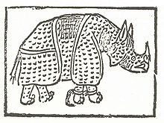
The Rhino Project: History
Created by Netscape in the autumn of 1997.
Great performance but heavy compilation time and memory-leak issues.
Interpretive mode created in 1998.
Released to Mozilla Foundation in April 1998: Rhino becomes open source.

Slide 16
Rhino, a Javascript Runtime
Open-source implementation of JavaScript written in Java.
Rhino compile JavaScript scripts to Java Bytecode which will run on a JVM.
An interpretive mode is supported: the generated compiled code is represented as an object that can be garbadge collected.
Allows the use of Java libraries, also called « Scripting Java ».

